Slide 1

Analysis of Players Performance in all three International formats (2013 – 2022)
TEAM:-
KOUSHIK
NAVEEN
AARISH
MENTOR:-
PUJALA BHANUPRAKASH

Slide 2
Agenda
Business Problem and Use case domain understanding(If Required)
Objective of the Project
Web Scraping – Details (Websites, Processor you followed)
Summary of the Data
Exploratory Data Analysis:
Data Cleaning Steps
Data Manipulation Steps
Univariate Analysis Steps
Bivariate Analysis Steps
Key Business Question
Conclusion (Key finding overall)
Q&A Slide
Your Experience/Challenges working on Web Scraping – Data Analysis Project.

Slide 3
EDA
Problem Statement:
To analyze the Players performance based on their Total runs, Batting Average, Strike rate, Total wickets, Economy in seasons from(2013 - 2022).
To predict best 15 Players from all Teams in each Format.

Slide 4
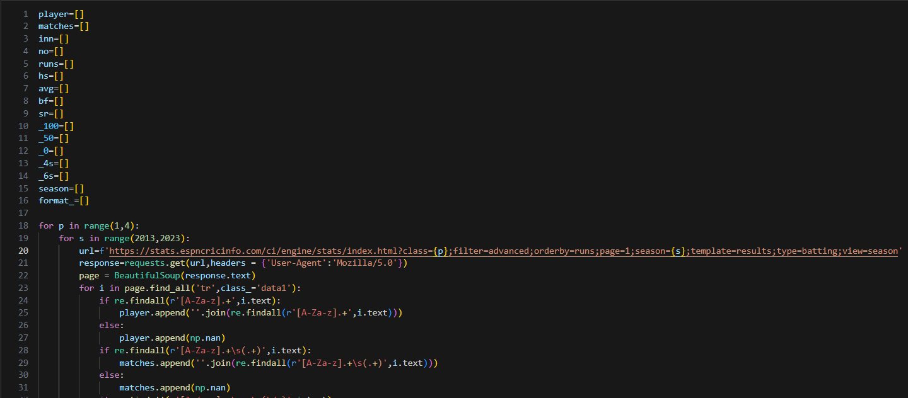
Web Scraping
Website:
https://www.espncricinfo.com/
Web Scraping Tools:
Requests
BeautifulSoup

Slide 5
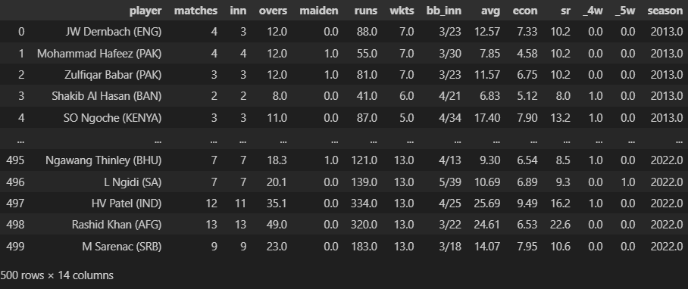
EDA
Data Cleaning:
Extracting Samples and features from raw data
Creating Data Frame
Analysing data types of features
Before cleaning:-

Slide 6
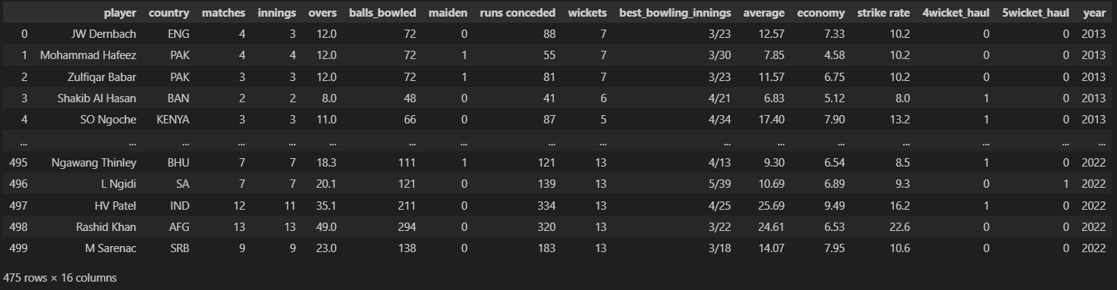
EDA
Data Cleaning:
Remove null values
Remove duplicates
Modifying datatypes
After cleaning:-

Slide 7
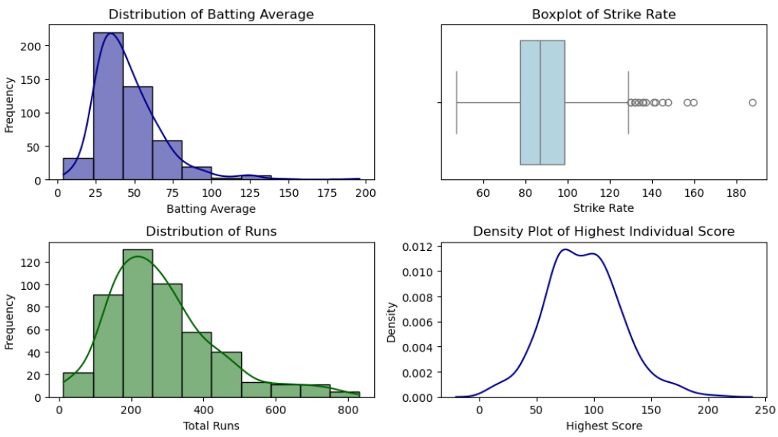
Data Visualization
Univariate Analysis:-
Insights:
Distribution of Batting Average :
The distribution is right-skewed, meaning most players have lower averages.
A peak around 30-50 suggests that many players fall within this range.
This suggests a strong divide between elite players and average performers.
2. Distribution of Runs
The distribution is approximately normal but slightly right-skewed.
Most players score between 100-400 runs, with fewer players reaching 600+.
This suggests a performance trend where most players score moderately, but a few dominate.

Slide 8
Data Visualization
Univariate Analysis:-
3. Boxplot of Strike Rate
The interquartile range (IQR) lies roughly between 75 and 100.
The presence of many outliers beyond 120 indicates some players have an extremely high strike rate.
A long whisker on the lower end suggests some players struggle with low strike rates.
This analysis can help identify aggressive versus conservative players.
4. Density Plot of Highest Individual Score
The peak around 75-100 indicates that most top scores fall in this range.
This distribution helps in understanding how often players score big.
It indicates that while high scores are possible, they are rare.

Slide 9
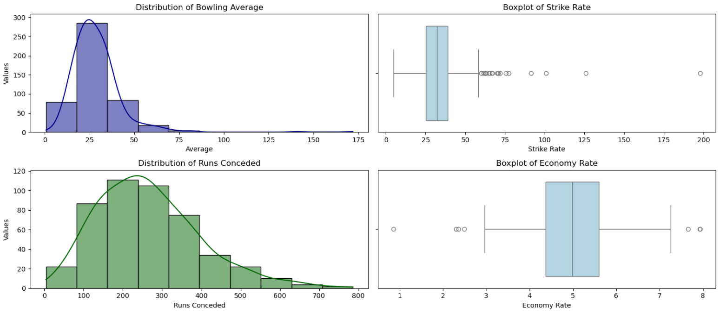
Data Visualization
Univariate Analysis:-
1. Bowling Average Distribution
The distribution is right-skewed, with most bowlers having an average between 15-30, indicating effective wicket-taking.
A small number of bowlers have averages above 50, suggesting inconsistent performance or limited bowling opportunities.
2. Runs Conceded Distribution
The distribution is more symmetrical, with most bowlers conceding between 100-300 runs, which aligns with normal match conditions.
A slight right skew suggests that a few bowlers have expensive spells, conceding 500+ runs.

Slide 10
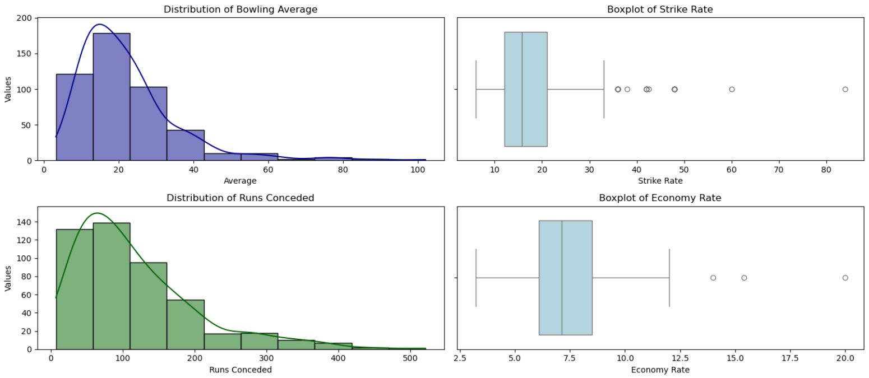
Data Visualization
Univariate Analysis:-
3. Strike Rate Boxplot
The majority of bowlers have a strike rate below 50, meaning they take wickets at a good rate.
Several outliers beyond 75, and even close to 200, indicate some bowlers struggle to take wickets frequently.
4. Economy Rate Boxplot
Most bowlers have an economy rate between 4-6, which is considered efficient.
A few outliers beyond 7-8 indicate bowlers who concede runs at a high rate, possibly in shorter formats or high-scoring games.

Slide 11
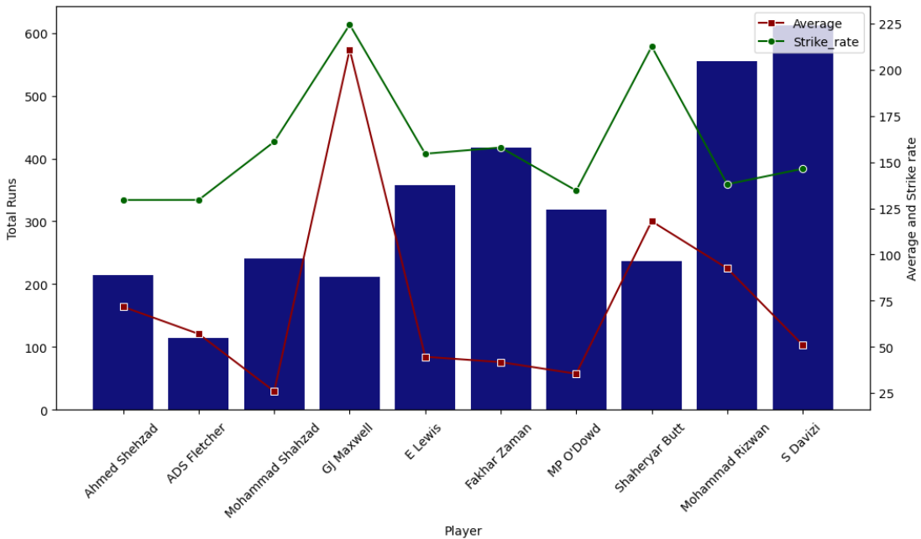
Data Visualization
Bivariate Analysis:-
Batting(T20) Insights: Runs, Averages, and Strike Rates
Top Scorers: Mohammad Rizwan and S Davizi have the highest total runs, indicating strong batting performances.
Strike Rate vs. Average: Some players, like GJ Maxwell, have a high batting average and strike rate , while others maintain a balance between strike rate and total runs.
Consistent Performers: Players like E Lewis and Fakhar Zaman show steady strike rates along with good total runs, demonstrating consistency.
Variations in Performance: Some players have a high strike rate but a lower total score, meaning they score quickly but might not play long innings.

Slide 12
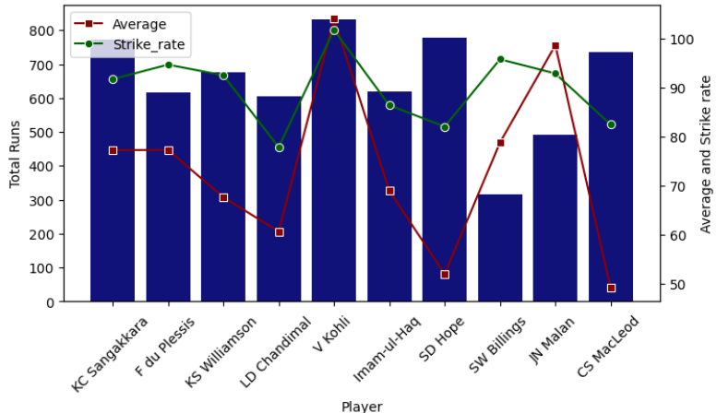
Data Visualization
Bivariate Analysis:-
Batting(ODI) Insights: Runs, Averages, and Strike Rates
Top Scorers: Virat Kohli and SD Hope have the highest total runs, indicating strong batting performances.
Strike Rate vs. Average: Some players, like JN Malan, have a high batting average but a lower total score, while others maintain a good balance between strike rate and total runs.
Consistent Performers: Players like KC Sangakkara, F du Plessis, and KS Williamson have both steady strike rates and good total runs, showing consistency.
Variations in Performance: Some players have a high strike rate but a lower total score, indicating they score quickly but might not play long innings

Slide 13
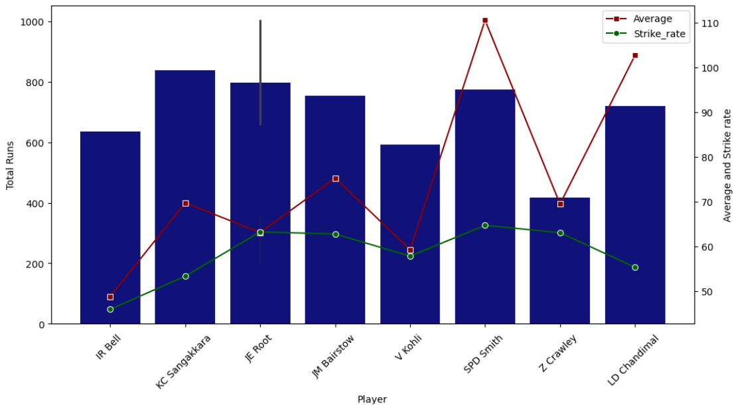
Data Visualization
Bivariate Analysis:-
Batting(TEST) Insights: Runs, Averages, and Strike Rates
Top Scorers: JE Root , KC Sangakkara and JM Bairstow have the highest total runs, showing their dominance in scoring.
Strike Rate vs. Average: Some players, like SPD Smith, have a high batting average and strike rate
Consistent Performers: KC Sangakkara and V Kohli demonstrate stability with steady strike rates and solid total runs.
Variations in Performance: A few players, such as Z Crawley , have moderate total runs but a more aggressive strike rate, indicating quick scoring abilities.

Slide 14
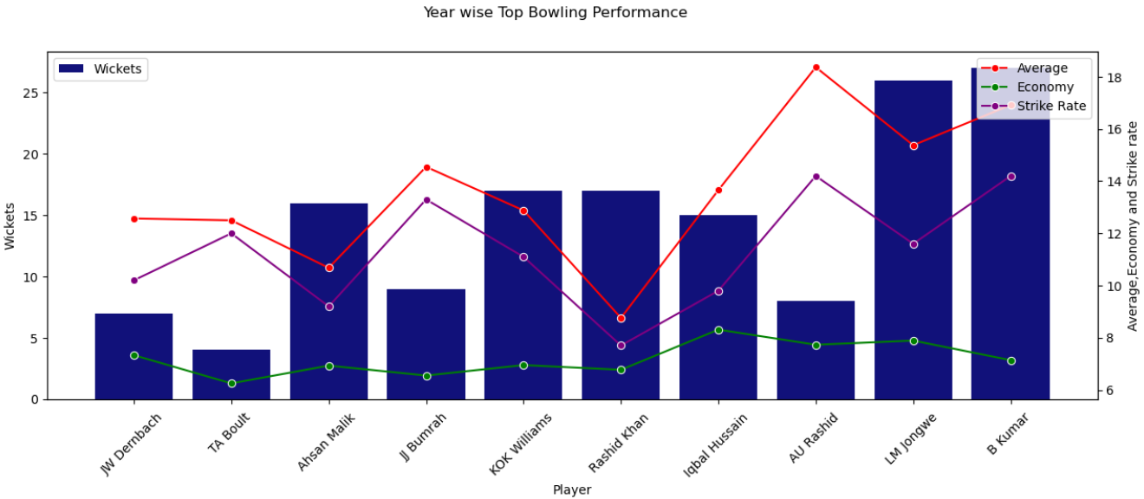
Data Visualization
Bivariate Analysis:-
Bowling(T20) Insights: Wickets, Averages Economy and Strike Rates
Top Wicket-Takers: LM Jongwe and B Kumar lead in total wickets, showing their effectiveness in taking wickets consistently.
Bowling Average Trends: Rashid Khan maintain lower averages, indicating efficiency in getting wickets without conceding too many runs.
Strike Rate Variations: Players like Ahsan Malik and Iqbal Hussain show fluctuations in strike rate, meaning their ability to take wickets per ball varies significantly.
Economy Rate Stability: The economy rate is relatively stable across bowlers, with minor variations, suggesting controlled spells.

Slide 15
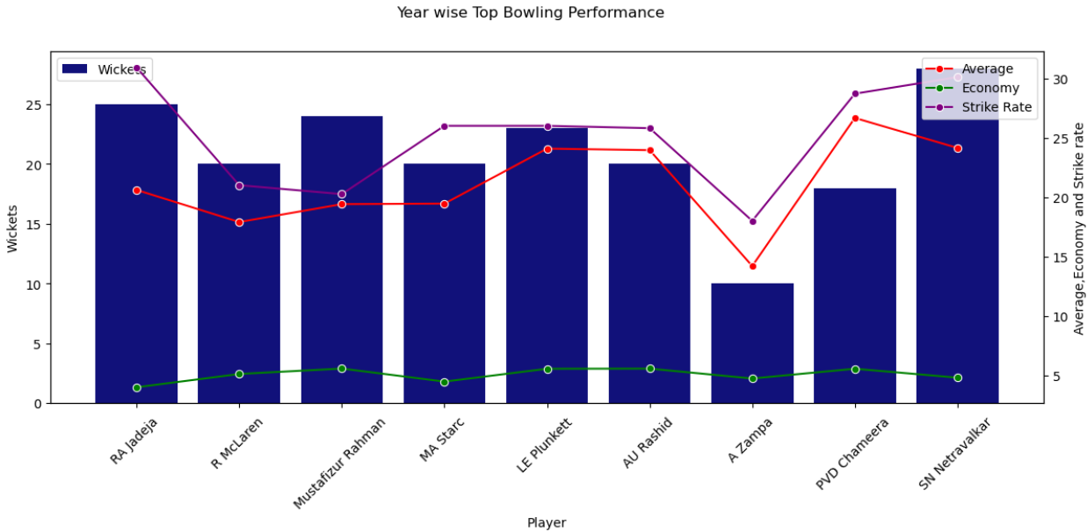
Data Visualization
Bivariate Analysis:-
Bowling(ODI) Insights: Wickets, Averages Economy and Strike Rates
Top Wicket-Takers: RA Jadeja and SN Netravalkar lead in total wickets, making them the most effective wicket-taking bowlers in this dataset.
Bowling Average: Most bowlers have an average between 15-20, except A Zampa, who has the lowest average, indicating he concedes fewer runs per wicket.
Strike Rate Trends: SN Netravalkar and RA Jadeja have relatively high strike rates, meaning they take more balls per wicket. A Zampa has the lowest strike rate, making him the quickest wicket-taker in terms of deliveries.
Economy Stability: Economy rates remain quite low and steady across all bowlers, indicating controlled spells.

Slide 16
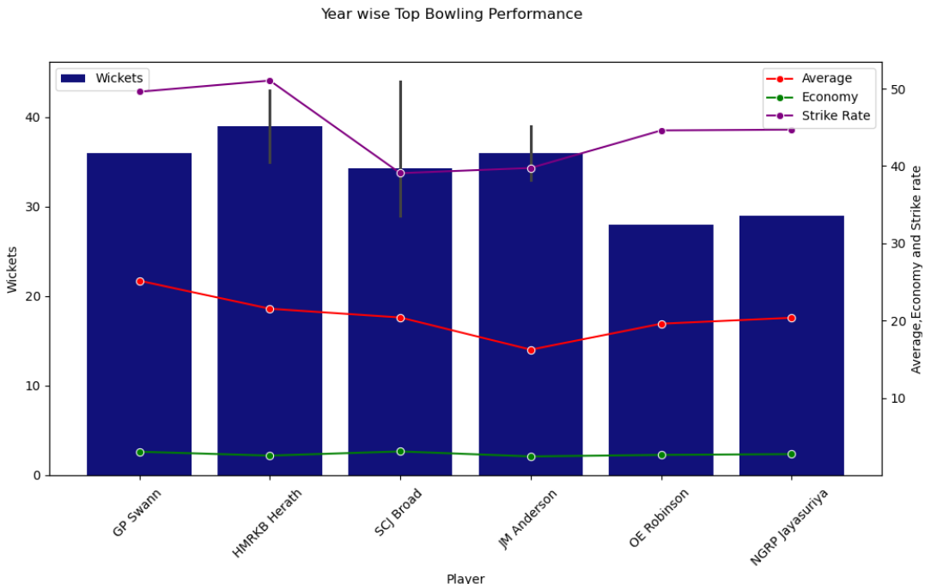
Data Visualization
Bivariate Analysis:-
Bowling(TEST) Insights: Wickets, Averages Economy and Strike Rates
Top Wicket-Takers: HMRKB Herath and SCJ Broad lead in total wickets, showcasing their dominance as bowlers.
Strike Rate vs. Average: SCJ Broad and JM Anderson maintain a balance between a lower bowling average and a reasonable strike rate, highlighting their consistency.
Economy Rates: Economy remains relatively stable across all players, indicating controlled bowling performances.
Variations in Performance: OE Robinson and NGRP Jayasuriya have lower total wickets but maintain a steady bowling average, suggesting effectiveness in limited spells.

Slide 17
Weight Scores for Test, ODI, T20 formats
Weighted Score for Test Cricket
Batting Weight Score Formula (Test)
Weighted Score=(0.5×Batting Average)+(0.3×Runs)+(0.2×Balls Faced)
Bowling Weight Score Formula (Test)
Weighted Score=(0.5×Bowling Average)+(0.3×Wickets)+(0.2×5-Wicket Hauls)
Weighted Score for One Day Internationals (ODI)
Batting Weight Score Formula (ODI)
Weighted Score=(0.4×Batting Average)+(0.3×Strike Rate)+(0.3×Runs)
Bowling Weight Score Formula (ODI)
Weighted Score=(0.4×Wickets)+(0.3×Economy Rate)+(0.3×Bowling Average)
Weighted Score for T20 Cricket
Batting Weight Score Formula (T20)
Weighted Score=(0.3×Strike Rate)+(0.4×Sixes)+(0.3×Runs
Bowling Weight Score Formula (T20)
Weighted Score=(0.4×Economy Rate)+(0.4×Wickets)+(0.2×Dot Balls

Slide 18
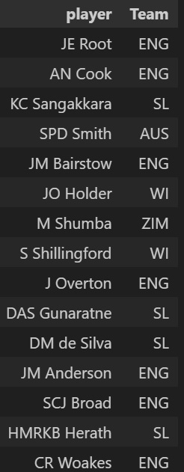
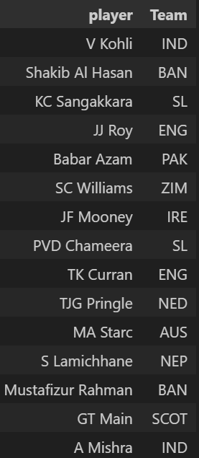
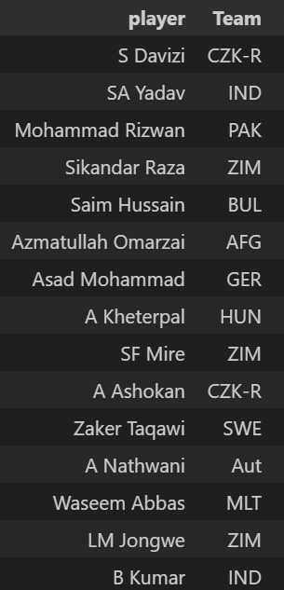
Best 15 Players from all Teams in all formats
TEST TEAM
ODI TEAM
T20 TEAM

Slide 19


Slide 20

THANK YOU

